Slide 1
Healthcare
Presentation by :
Anjali Patil
Shivani Gavali
Snehal Dumbre
Ankita Gurav
Thipparam Sumanth
Yash Chavan

Slide 2
KPIs
Total Discharge
Patient Days
Net Patient Revenue
Revenue Trend
Patient Stays
Sate wise no. of hospital / revenue
Type of Hospital Revenue
MTD/QTD/YTD Revenue
Total Patient / Total Doctor / Total Hospital

Slide 3
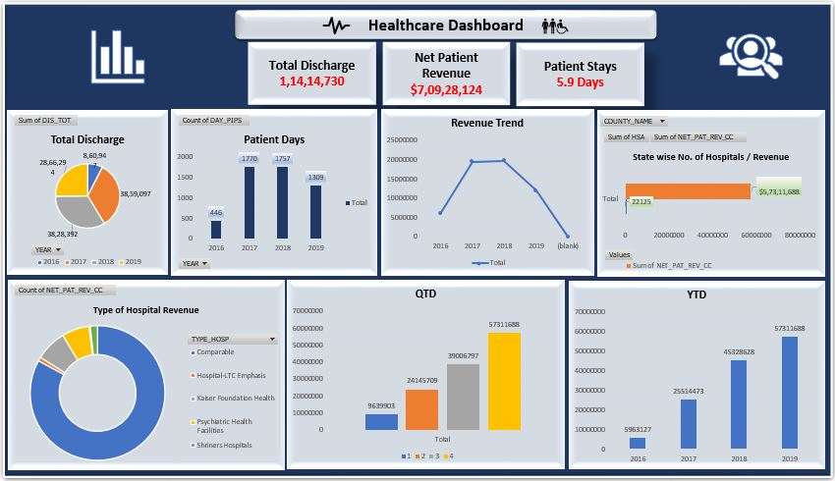
Excel :

Slide 4
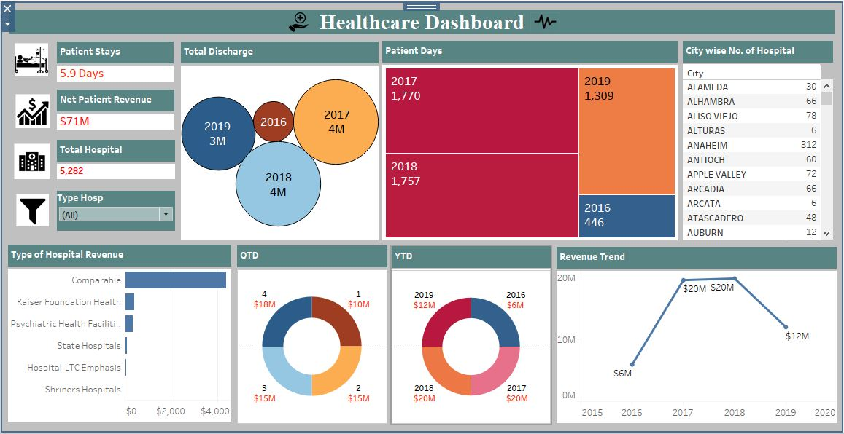
Tableau :

Slide 5
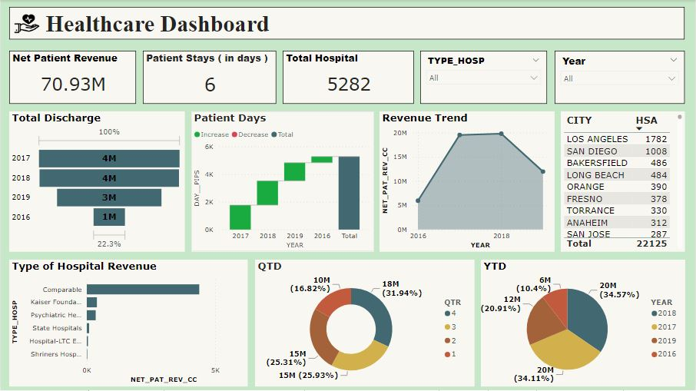
Power BI :

Slide 6
Key Takeaways :
Total Discharge : Understanding Total Discharges helps in forecasting future bed requirements, staffing needs, and resource allocation to ensure optimal utilization. A high number of discharges could indicate efficient turnover of beds and resources. It's important to analyze the underlying reasons for the decrease in total discharge and consider the broader context of healthcare delivery and outcomes to determine whether it is a positive or negative trend.
Patient Days : A decrease in patient days could indicate that the healthcare facility is becoming more efficient in treating patients, leading to shorter lengths of stay. This can be positive as it may result in cost savings and better utilization of resources. A decrease in patient days may also suggest that patients are experiencing better health outcomes, requiring shorter hospital stays. It is important to understand the underlying reasons behind the decrease to determine if it is a positive or negative trend.
Net Patient Revenue : Analyzing Net Patient Revenue can provide several insights into the financial health and performance of a healthcare facility. Monitoring NPR over time can help assess whether revenue from patient services is increasing, decreasing, or remaining stable. Significant changes in NPR may indicate shifts in patient volumes, payer mix, or pricing strategies. Here, Net Patient Revenue is $70.93M.

Slide 7
Revenue Trend : Here, since 2016 to 2018 the revenue trend has increased and since 2018 to 2019 it goes on decreasing. Addressing a decreasing revenue trend in healthcare requires a strategic approach that considers various factors contributing to the decline. So the analysis suggest to improve operational efficiency to reduce waste and increase productivity. This could involve streamlining administrative processes, improving patient flow, or implementing technology solutions to automate tasks. Focus on improving clinical outcomes and quality of care to attract patients and maintain a positive reputation. This can lead to increased patient volume and revenue.
Patient Stays : Shorter stays can reduce healthcare costs by minimizing the resources needed for each patient. Patients generally prefer shorter stays as it reduces their time away from home and family. Shorter stays can help healthcare facilities operate more efficiently by freeing up beds for other patients. So, streamline admission, treatment, and discharge processes to reduce length of stay. Deliver high-quality care to prevent complications and expedite recovery.
State wise no. of hospital / revenue : In our data, Los Angeles has higher no. of hospitals (1782) while Cedarville and Colusa have lower which is 2. To manage the number of hospitals and revenue across states effectively develop a strategic plan that aligns the number of hospitals with population needs and market demand in each state. Conduct a thorough analysis of each state's healthcare market to determine the optimal number of hospitals and potential revenue opportunities. Implement robust financial management practices to optimize revenue and ensure sustainability of hospitals in each state. Allocate resources efficiently based on the healthcare needs and revenue potential of each state. Focus on providing high-quality care to attract patients and improve revenue generation in each state.

Slide 8
Type of Hospital Revenue : "Type of hospital revenue" refers to the different sources of income that hospitals generate. This can include revenue from various services and activities. Here, Type of Hospital Revenue is more for Comparable and least for Shriners Hospitals. Having diverse mix of revenue sources can be beneficial for hospitals. To improve the Type of hospital revenue, increase efforts to market hospital services to the community and target populations to increase patient volume. Identify opportunities to expand services to meet the needs of the community. Collaborate with other healthcare providers or organizations to offer complementary services or enter new markets. This could include partnerships with primary care providers, specialty clinics, or community organizations.
QTD Revenue : QTD Revenue has been increasing after every quarter. An increase in quarterly revenue can indicate positive growth and performance. Here are some suggestions to maintain or enhance this trend : Determine what factors are contributing to the increase in revenue. This could include new service offerings, increased patient volume, or improved billing and collections processes. Ensure that the quality of care provided remains high to maintain patient satisfaction and loyalty, which can lead to repeat business and positive word-of-mouth referrals. By staying vigilant and continuing to focus on areas of strength, you can sustain and potentially further increase your revenue growth.

Slide 9
YTD Revenue : Here, since 2016 to 2018 the revenue trend has increased and since 2018 to 2019 it goes on decreasing. It indicates a concerning trend that may require attention. Here are some suggestions to address this : Determine the underlying reasons for the decrease in YTD revenue. This could include changes in patient volume, competition or economic conditions. Increase patient engagement and satisfaction to attract more patients and retain existing ones. This could include improving the patient experience, providing more personalized care, and offering additional services. By addressing these areas, you can work towards reversing the downward trend in YTD revenue and improving the financial health of the organization.
Total Hospital : Analyzing the total number of hospitals can provide valuable insights into healthcare infrastructure, accessibility, and regional healthcare disparities. When considering the total count of hospitals, it's important to balance accessibility and efficiency with quality of care. It suggests to conduct a thorough analysis of population demographics, health needs, and existing healthcare infrastructure to determine the optimal number of hospitals in each region. By carefully considering all factors, healthcare systems can optimize the total count of hospitals to best serve the needs of their communities.

Slide 10
Thank you

